Slide 1
Sequential pattern mining
Association rule mining does not consider the order of transactions.
In many applications such orderings are significant. E.g.,
  in market basket analysis, it is interesting to know whether people buy some items in sequence,
    e.g., buying bed first and then bed sheets some time later.
  In Web usage mining, it is useful to find navigational patterns of users in a Web site from sequences of page visits of users

Slide 2
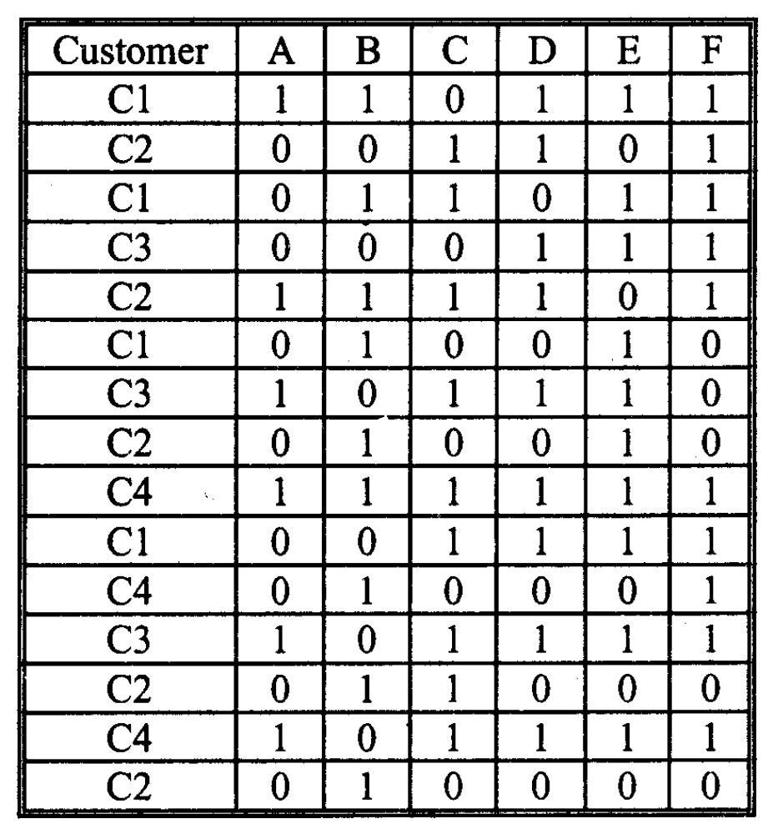
Sequential pattern mining
Introduction
Sequence Data
4 customers
The transactions are ordered chronologically

Slide 3
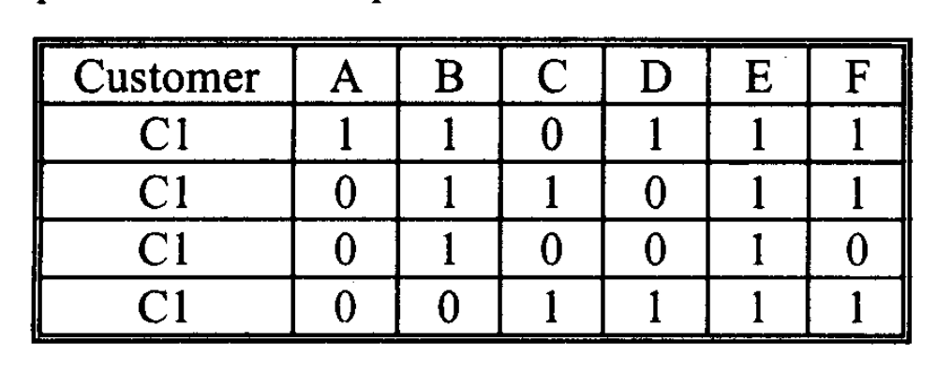
Sequential pattern mining
Introduction
Event: In Sequence Mining terminology a transaction is called an Event
Sequence: A sequence is an ordered list of events

Slide 4
Sequential pattern mining
Introduction
A sequence α is denoted as (α₁ → α₂ → … → α_{q}) where α_{i} is an event

Slide 5
Sequential pattern mining
Introduction
Sub-Sequence
It is a sequence within the sequence, preserving that order
Its events may not be adjacent, but their ordering should not violate the ordering of the bigger sequence
A subsequence can be obtained from a sequence by deleting some items and/or events

Slide 6
Sequential pattern mining
Introduction
Frequency & Frequent Sequence
The frequency of a sequence is the total number of input sequences that support it
A frequent sequence is a sequence whose frequency exceeds some user-specified threshold
A frequent sequence is maximal if it is not a sub-sequence of another frequent sequence

Slide 7
Sequential pattern mining
Introduction
The rationale behind frequent sequences lies in detecting precedence and causal relationships that make them statistically remarkable

Slide 8
Sequential pattern mining
Introduction
The sequences of all customers can be written in the following form

Slide 9
Sequential pattern mining
Examples:
(A, C) is a sub-sequence of sequence 2, 3 & 4, but not of 1
The sub-sequence (A) → (C) is a subsequence of sequence 1
The sub-sequence (A) → (C), means that item C appears in a transaction after (not necessarily, immediately after) another transaction containing A

Slide 10
Sequential pattern mining
Examples:
The frequency of (A, C) is 3, because we do not count multiple occurrences of (A, C) in the same sequence
The total number of sequences that support (A, C) are 3 namely sequence 2, 3 and 4

Slide 11
Sequential pattern mining
Examples:
The frequency of (B) → (D) is 2, as sequence 1 and 4 support it
Note that sequence 4 supports (B, E) → (B) but it does not supports (B) → (B, E)

Slide 12
Sequential pattern mining
Introduction
Normally, a sequence mining problem is concerned with the temporal order of events within a sequence
However, we can also focus on the temporal distance between the events. That is (A) → (C) should indicate the temporal gap between the transactions containing A and the transaction containing C
Period of times are relevant because most relationships between two events ceases to be effective after some period of time (e.g. consuming a beverage and stomach upset)

Slide 13
Sequential pattern mining
Introduction
Thus, we can specify the time distance in terms of a distance threshold, d
So, (B) →_{d} (B, E) denotes the event (B, E) occurs within the distance of d transactions after the transaction containing B

Slide 14
Sequential pattern mining
Introduction
Example:
There is no sequence which supports (A, B, D) →₁ D
However, (A, B, D) →₂ D is supported by sequence 4

Slide 15
An example
Let I = {1, 2, 3, 4, 5, 6, 7, 8, 9}.
Sequence ⟨{3}{4, 5}{8}⟩ is contained in (or is a subsequence of) ⟨{6} {3, 7}{9}{4, 5, 8}{3, 8}⟩
  because {3} ⊆ {3, 7}, {4, 5} ⊆ {4, 5, 8}, and {8} ⊆ {3, 8}.
  However, ⟨{3}{8}⟩ is not contained in ⟨{3, 8}⟩ or vice versa.
  The size of the sequence ⟨{3}{4, 5}{8}⟩ is 3, and the length of the sequence is 4.

Slide 16
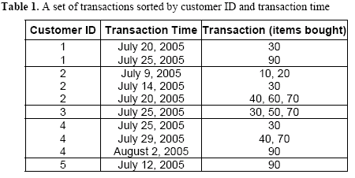
Example

Slide 17
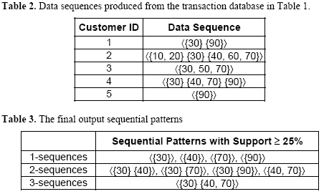
Example (cond)

Slide 18
Sequential pattern mining
GSP Algorithm
The algorithms for solving sequence mining problems are mostly based on the A-priori algorithm
One such algorithm is GSP algorithm
It is exactly like A-priori algorithm and makes multiple passes over the database
In the first pass, all 1-sequences are counted. From the frequent items, a set of candidate 2-sequences are formed, and another pass is made to gather their support

Slide 19
Sequential pattern mining
GSP Algorithm
The frequent 2-sequences are used to generate the candidate 3-sequences. Pruning is done among the candidates to eliminate any sequence, at least one of whose sub-sequence is not frequent
The generation of candidates sequences are as follows:
For the first pass all the items are considered as 1-sequence
Suppose after the first pass the 1-sequences (A), (B) & (C) are found to be frequent

Slide 20
Sequential pattern mining
GSP Algorithm
The following 2-sequences would be generated
(A) → (B)
(B) → (A)
(A) → (C)
(C) → (A)
(B) → (C)
(C) → (B)
(AB)
(AC)
(BC)

Slide 21
Sequential pattern mining
GSP Algorithm
Suppose after the next pass, the following 2-sequences are found to be frequent
(A) → (B)
(B) → (C)
From these 2-sequences, the following 3 sequence would be generated
(A) → (B) → (C)

Slide 22
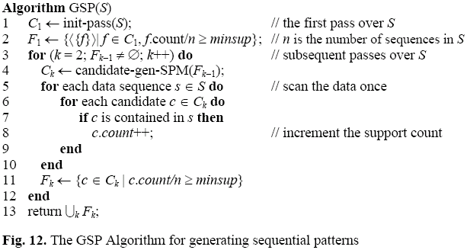
GSP mining algorithm
Very similar to the Apriori algorithm

Slide 23
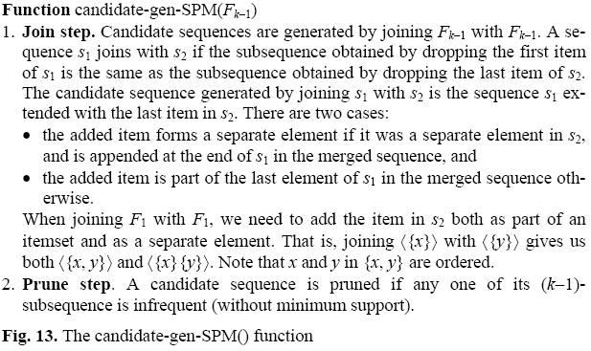
Candidate generation

Slide 24
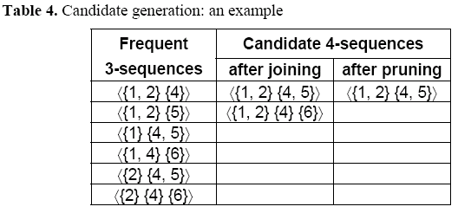
An example

